Slide 1
GULF FILE

Slide 2
Meaning and Objective
Gulp is a popular task runner in the JavaScript ecosystem, often used for automating repetitive tasks in web development, including the minification of CSS files.

Slide 3
To minimize CSS files using Gulp, you can perform following steps
Install Gulp
If you haven't already installed Gulp globally on your system, you can do so via npm (Node Package Manager) by running:
npm install -g gulp

Slide 4
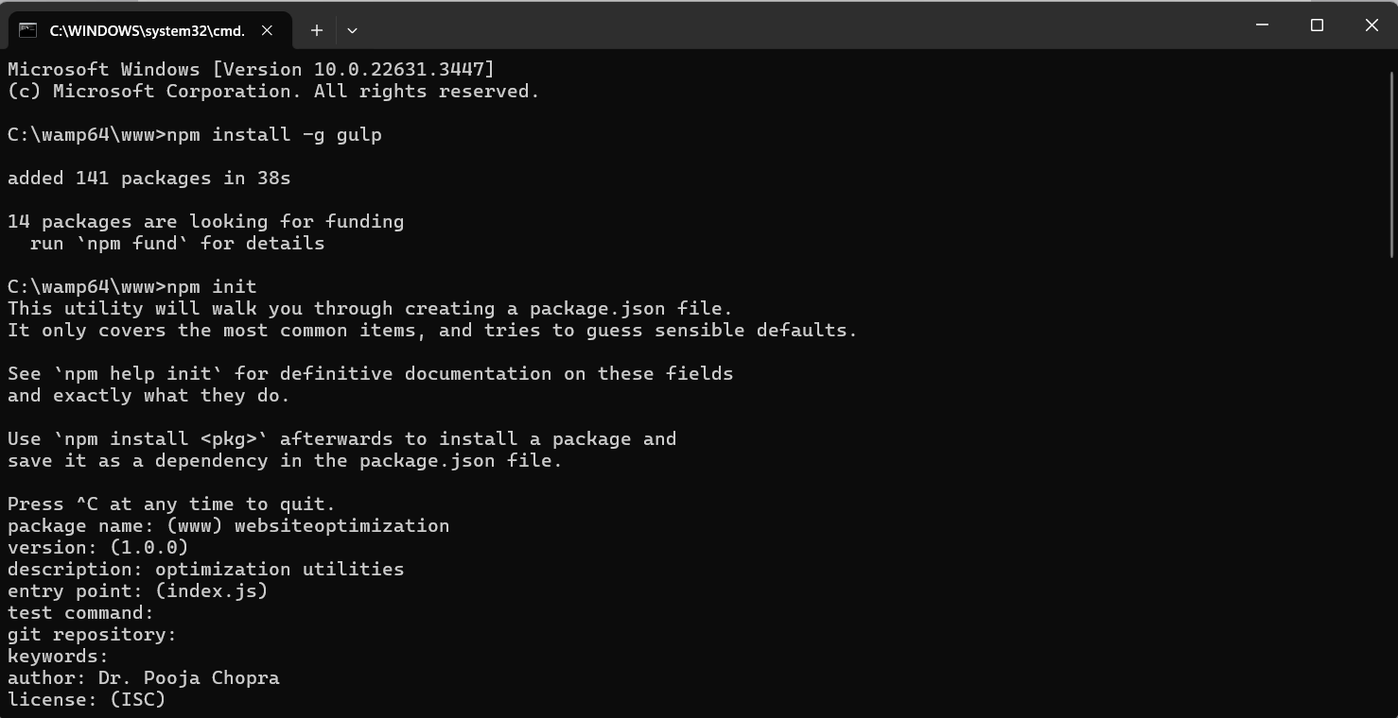

Slide 5
Set Up Your Project: Navigate to your project directory in the terminal and initialize npm if you haven't already done so:
npm init
Follow the prompts to set up your package.json file.

Slide 6
Install Required Packages: Install gulp and gulp-cssmin packages as dev dependencies:
npm install --save-dev gulp gulp-cssmin
npm install gulp-clean-css --save-dev

Slide 7
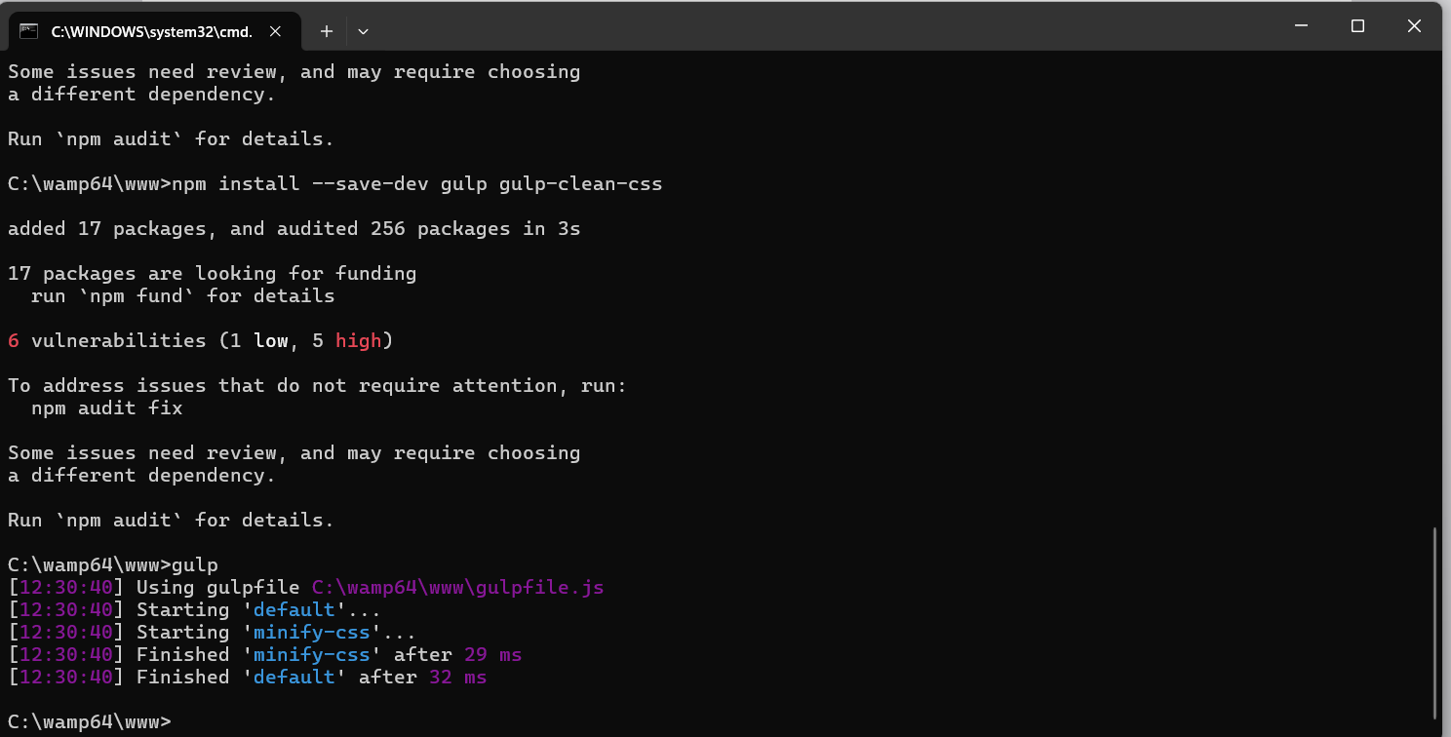

Slide 8
Create a Gulpfile: In your project directory, create a file named gulpfile.js. This file will contain the tasks for Gulp.
Write Gulp Task: Inside gulpfile.js, define a Gulp task to minify CSS files. Here's an example:

Slide 9
const gulp = require('gulp');
const cleanCSS = require('gulp-clean-css’);
// Task to minify CSS files
gulp.task('minify-css', () => {
return gulp.src('CSS/*.css') // Path to your CSS files
.pipe(cleanCSS()) // Minify the CSS files
.pipe(gulp.dest('dist')); // Destination folder for the minified CSS files
});
// Default task
gulp.task('default', gulp.series('minify-css'));

Slide 10
This task takes all CSS files from the src directory, minifies them, renames them with a .min.css extension, and saves them into the dist directory.

Slide 11
Run the Gulp Task: In the terminal, navigate to your project directory and run the Gulp task:
Gulp
This will execute the default Gulp task defined in gulpfile.js, which in this case, is the minifyCSS task.
That's it! Gulp will now minify your CSS files whenever you run the gulp command in your terminal.
You can further customize this process according to your project requirements.

